Slide 1
Ms. Nancy Orvis, DHA Health Ops DIR, Chief Bus. Arch. & Stds.
Mr. Alan “Bart” Bartholomew, DHA PfM&CR, EA Branch Chief
Strategic Use
of Information and Data Models
by the DoD Defense Health Agency
August 2016

Slide 2
Outline
DHA Vision
Strategy → Improve Information Infrastructure as key Organizational Capability
Types of Information that Models need to support
Patient/Person centered
Data Warehouse environment
Enterprise Data and Architectural Management
Benefits
Examples
Questions

Slide 3
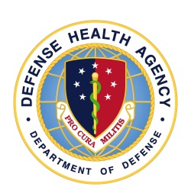
DHA Vision
“A joint, integrated, premier system of
health, supporting those who serve in
the defense of our country.”

Slide 4
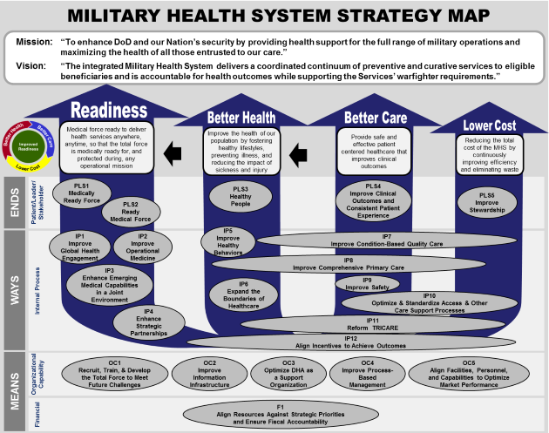
MHS Strategy Map → Enterprise Improvement Plan → Organizational Capability:
Improve Information Infrastructure
Support the healthcare team in providing efficient clinical activities with appropriate information technology tools
Create decision support for evidence-based management and evidence-based care in an integrated delivery system with aligned incentives
Enable continuous learning and knowledge management with real-time relevant information
Support dissemination of proven practices, and continuous improvement and innovation

Slide 5
Information and Data Models need to support:
Transactional and Longitudinal Processing of Patient and Person Data
Data Stores and Warehouses for Research, Population, Resources, and Organizational Views of Data
Architects, Managers, and Implementers need to have ways to understand and digest what data the organization is trying to manage
Convey that understanding so that costs can be managed
DHA is standing up the MHS Executive Data Council (Data Governance & Data Management)

Slide 6
Benefits of DoD’s Use of the Federal Health Information Model (FHIM)
Continual Improvement FHIM provides a strong baseline model since it is continually evolved by consensus among Federal partners with a consistent model-driven architecture approach, led by the Federal Health Architecture (FHA), and sponsored by the Office of the National Coordinator (ONC).
Interoperability
Standards
Interoperability FHIM provides a model that supports semantic interoperability and harmonization of information with Federal partners.
Data Migration
Standards FHIM leverages the HL7 Reference Information Model and supports existing national health standards.
Continual Improvement
Architecture Development
Data Migration FHIM provides an information model for mapping legacy MHS systems’ data to the new EHR (MHS GENESIS) in support of the goal for modernization.
FHIM Provided Benefits
Architecture Development Provides a platform for MHS to build fit-for-purpose architecture views, e.g., the Medical Theater of Operations and high-level Data Domain Model for the MHS Enterprise Architecture Branch.

Slide 7
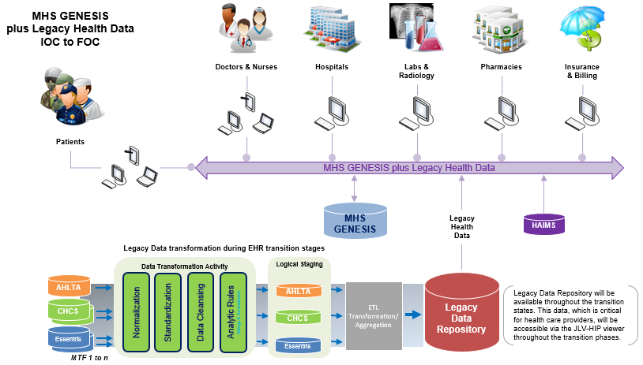
MHS GENESIS and Legacy Systems - Initial to Final Operating Capability (Example 1 context)
Notes:
Background
The Department of Defense’s (DoD) EHR is an enterprise‐wide clinical information management system that provides secure online access to active duty Service members, retirees, and their beneficiaries’ health care records. It is currently the largest healthcare system in the United States, serving 9.5 million beneficiaries. In an effort to improve interoperability among the DoD, VA and the private sector, the Department of Defense Health Management System (DHMS) recently acquired a “new EHR” commercial off-the-shelf (COTS) product. This new EHR, named MHS GENESIS, will eventually replace approximately 50 legacy systems.
There is a planned IOC to FOC schedule to deploy MHS GENESIS, with an initial increment to be deployed January 2017(?). As MHS GENESIS is being implemented, patient health care data from legacy systems will need to be accessible. However, not all patient data will be migrated to MHS GENESIS. This remaining legacy data will be stored in a repository, where critical data will be accessed via data exchange services (DES) and viewed by health care providers through a web-based integrated system called the Defense Medical Information Exchange (DMIX) Joint Legacy Viewer (JLV) Health Information Portal (HIP).
The Challenge
One of the biggest challenges when transitioning legacy clinical data is determining the type of data (i.e., metadata) required to be transitioned from legacy systems. Legacy data also needs to be standardized and normalized in order to be transitioned. Diverse data sources and database technologies, global and local (site-specific) systems, inconsistent use of data formats and standards, dis-integrated data architecture models, and lack of data governance are difficulties that MHS must overcome for a successful MHS GENESIS implementation.
In the next slide, we’ll look at an overview of our approach to:
Identifying what types of data (i.e., physical components) are required
Harmonizing physical components by mapping/aligning them to accepted business terms, definitions and relationships (i.e., logical semantic structures)
Standardizing them based on national and MHS-specific health standards.

Slide 8
Identification → Harmonization → Standardization (Example 1 detail)
Common National Standards,
Vocabulary & Terminology
Data Requirements
(FHIM & MHS Enterprise Data Model)
Business-speak
Logical View
Semantics/Design
Identification
Maps
Technology-speak
Physical View
Technical
CDR
Data Element Unique Name
CHCS
Data Element Unique Name
Essentris
Data Element Unique Name
MHS
AHLTA/CDR
MHS
CHCS
MHS
Essentris
Armed Forces Health Longitudinal
Technology Application /
Clinical Data Repository
Composite Health Care System
In-patient Care System
Notes:
Below the dotted line are the MHS system-specific Physical Data Models and data dictionaries that are specified in “technology-speak,” which is dependent on the database technology (Cache, Oracle, SQL Server). These database structures were not built based on any authoritative design blue print, i.e., an enterprise data model (EDM), to use as a foundation for data requirements. Consequently, there were no maps that align the legacy physical data model (PDM) to the business data requirements that would be found in an authoritative EDM.
Above the dotted line are the FHIM and MHS Enterprise Data Model and other data requirements that are specified in “business-speak.” They are based on formal standards, rules and data structures ... and are completely independent of the chosen technology used to implement them. A new, first-cut EDM has developed, and will be extended, using the Federal Health Information Model (FHIM) as a reference model.
Identification/Alignment Maps
Data Architecture methods and best practices can help define the MHS data transition requirements from IOC to FOC.
Mapping/aligning physical tables and data elements to the MHS Enterprise Data Model provides us with the specific, technical identification required to harmonize terms and data value sets, and standardize on a common business attribute name and definition. This is infinitely more efficient than attempting to map a myriad technical systems to each other.
This alignment of existing systems to logical design requirement is an exercise in reverse engineering that also points out gaps in our MHS Enterprise Data Model; which in turn, can provide feedback to the FHIM where appropriate. These models and maps aid in developing unambiguous requests to propose execution of the programming involved for migration, archiving, and warehousing the actual MHS data and developing the data architecture artifacts by the architects.
Model and mapping metadata can then be loaded into the MHS EA Common Repository for reporting and analytical purposes via the SEMOSS business intelligence tool.

Slide 9
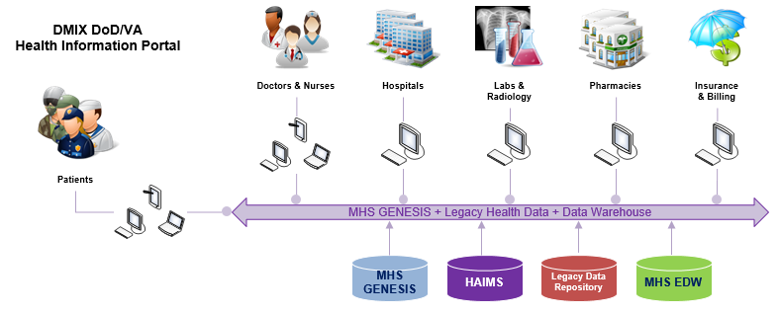
DMIX DoD/VA Health Information Portal Maps: FHIM ←→ MHS Enterprise ←→ MHS Systems Data Maps (Example 2)
Federal Health Information Model
Military Health System Enterprise Data Model
Military Health System Physical Data Models
Data Domains
Data Subject Areas
MHS GENESIS
Legacy Data Repository
HAIMS (images & docs)
MHS Data Warehouse
...
Entities
Entities
Alignment
System Tables
Attributes
Common
Map
Attributes
Data Elements
Relationships
Relationships
Relationships
Notes:
The DMIX DoD/VA Joint Legacy Viewer (JLV) – Health Information Portal provides data from a variety of source files.
Aligning business data requirements to the technical data structures allows MHS to exchange data and information, both internally and externally, in an efficient and reliable manner.
The FHIM to MHS Enterprise Data Model Common Map and the MHS Enterprise Data Model to MHS System Data Models Alignment Maps are used to show:
the traceability from the business data requirements to the individual system physical tables and data elements,
gaps between business data requirements and system metadata, and
gaps between actual system metadata and what’s defined (and needs to be included) in the logical data model.
The maps will then be used to flag data requirements as targeted for: 1) migration into GENESIS, 2) MHS Legacy Reference Repository, and 3) the MHS Data Warehouse environment.

Slide 10
DaVinci Project – DoD/VA Advanced Analytics Joint Incentive Fund Project (Example 3)
Purpose: A Data store for advanced research and analytics purposes between DoD and VA
Sources of Data: Data from the DMIX-Data Exchange Service for the Joint Legacy Viewer (JLV) and other sources will be implemented in an Observational Medical Outcomes Partnership construct (see OMOP.org)
Problem: Source Data Dictionary supplied for project for DMIX-DES interface is an Excel file with column titles, but no context for implementers
Analysis: The MHS EA program supplied a MHS Data Model – FHIM Mapping Context to Project Leads so that an implementable solution could be constructed
FHIM – MHS Enterprise Data Model (EDM) Map
MHS EDM to CHCS Physical Data Model Map
MHS EDM to CDR Physical Data Model JLV Map

Slide 11
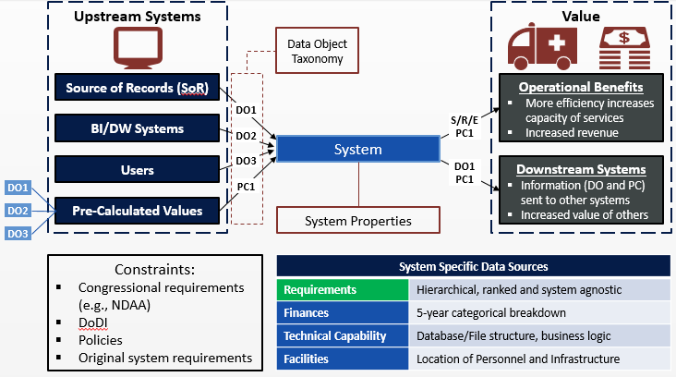
DHA Zero-based Budget Review (Example 4a)
This model shows the interactions and key considerations of the Enterprise Service Systems. These interactions trace the connection between each System, the data it contains, the Data-Outputs and the Business Processes they support and monitor.
IT System
Operational Activity
Impact
Frequency
System ₁
Creates
Data-Output ₃
Supports
BusinessProcess ₄
Mandated?
Cost
Efficiency
DataObject ₂
Provides
Used In

Slide 12
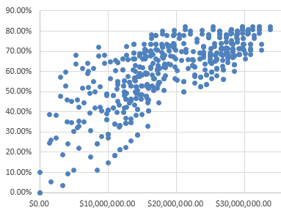
DHA Zero-based Budget Review (Example 4b)
Decision Making
Potential Analysis Results
Each Registry provides value through two dimensions:
The clinical data collected, structured and curated within the Registry (Data Coverage)
The functionality by which this data is stored, accessed and presented within the Registry (Functional Fulfilment)
Approach
A final set of 136 mutually exclusive requirements representing the capability of registries were used to evaluate each System’s functional fulfilment
The MHS Data Domains, an Enterprise Architecture product, has been used as the taxonomy for organizing the data provided by each System.
The valuation was executed across 512 unique system combinations and a number of hypothetical optimal configurations were chosen to undergo a more thorough analysis.
System Health Grid
Scenario 2 (5, 6, 7, 9)
Scenario 1 (4, 5, 6, 7)
System 9
System 6
System 5
Scenario 3
(1 ,4, 6, 7, 9)
System 7
System 4
System 2
System 8
System 1
System 3
* Size is cost

Slide 13
Questions?
Ms. Nancy Orvis, DHA Health Ops DIR, Chief Bus. Arch. & Stds.,
nancy.j.orvis.civ@mail.mil
Mr. Alan “Bart” Bartholomew, DHA PfM&CR, EA Branch Chief,
alan.bartholomew1.civ@mail.mil

